Slide 1
Media 175 Principles of Digital Photography
Photographer Helen Levitt
Presented by Debra Faustini
Oct. 2, 2015

Slide 2
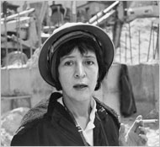
Helen Levitt American, 1913-2009
photo: estate of Helen Levitt / Laurence Miller Gallery, NY
“Since I’m inarticulate, I express myself with images.”- Helen Levitt

Slide 3
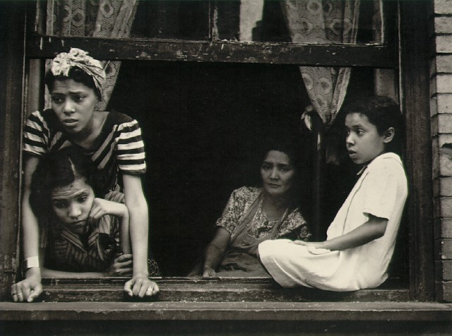
Throughout her long career, Helen Levitt’s photographs have consistently reflected her poetic vision, humor, and inventiveness as much as they have honestly portrayed her subjects—men, women, and children living it out on the streets and among the tenements of New York.
Photo by Helen Levitt, New York c. 1942

Slide 4
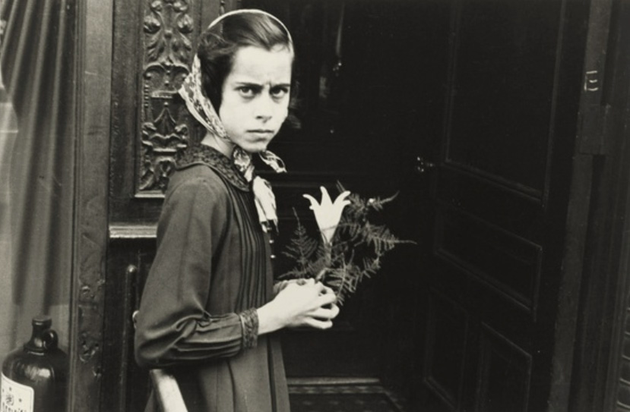
Photo by Helen Levitt

Slide 5
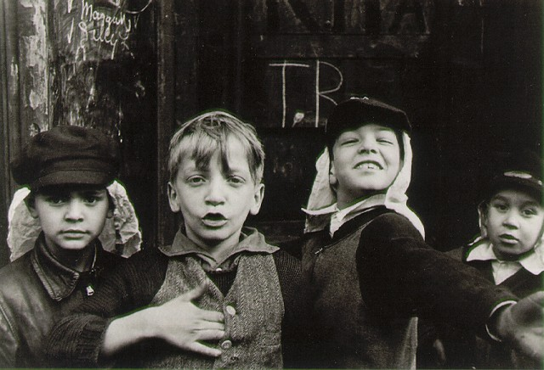
Photo by Helen Levitt, New York c. 1940
It wasn't until she saw the work of Henri Cartier-Bresson at the Julien Levy Gallery that she started to think of photography as art, a realization that made her ambitious to take "a picture that would stand up by itself".

Slide 6
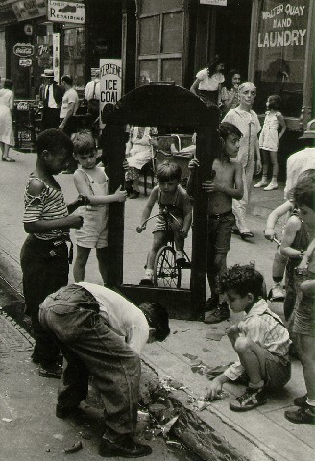
Photo by Helen Levitt, New York c. 1945

Slide 7
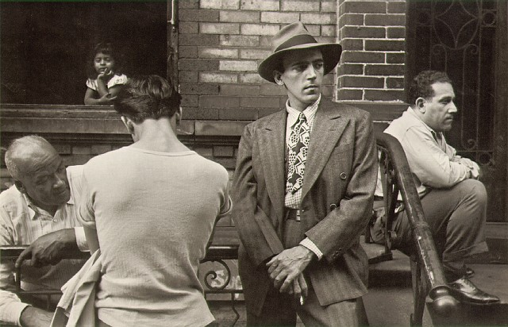
Photo by Helen Levitt, New York c.1945

Slide 8
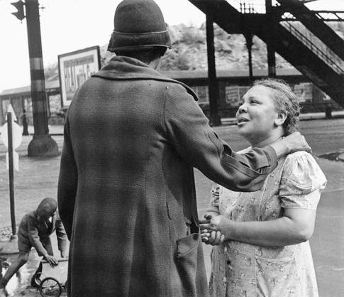
Photo by Helen Levitt

Slide 9
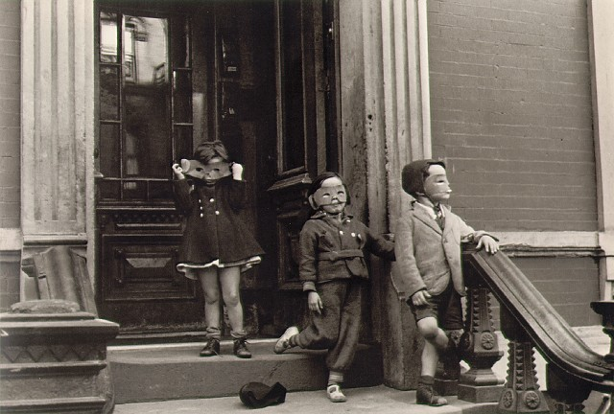
Photo by Helen Levitt, New York c. 1942

Slide 10
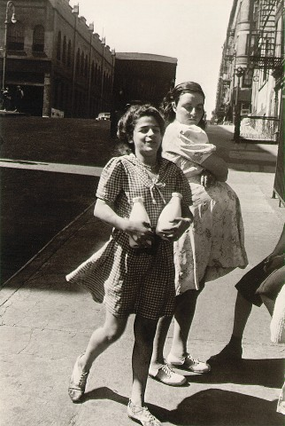
Photo by Helen Levitt, New York c. 1942

Slide 11
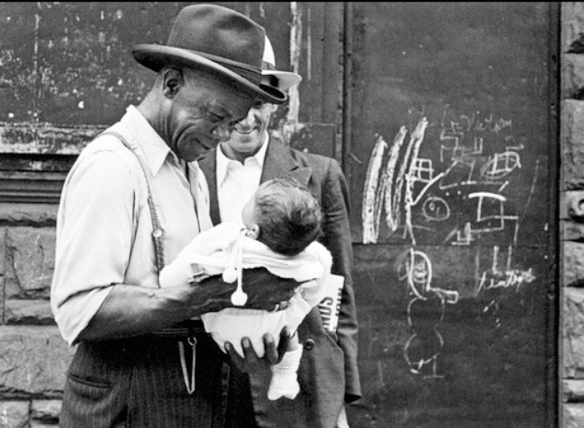
Photo by Helen Levitt

Slide 12
The End
Resources:
http://www.masters-of-photography.com
http://www.laurencemillergallery.com/artists/helen-levitt
http://www.telegraph.co.uk/news/obituaries/culture-obituaries/art-obituaries/5209410/Helen-Levitt.html
http://www.atgetphotography.com/The-Photographers/Helen-Levitt.html

